Slide 1



DSA 8302 COMPUTATIONAL TECHNIQUES IN DATA SCIENCE
Racing the Clock
Optimising the Miraa Supply Chain with VAM
From the highlands of Meru County to markets across Kenya, a perishability-adjusted transportation model that delivers freshness at minimum cost.
Strathmore University Institute of Mathematical Sciences
Notes:
Welcome slide. Emphasis on perishability — miraa must reach markets within 24-48 hours.

Slide 2



THE COMMODITY
Miraa Green Gold of Meru
24-48 hrs
Catha edulis
6,000 kg
window from harvest to market before potency lost
highly perishable stimulant crop, Kenya's highland gem
daily batch optimised in this study across 3 sources
"Speed is not an option. It is the entire business model. VAM gives Meru farmers a scientific edge."
Notes:
Explain what miraa is; its economic importance; and why the clock creates an optimization imperative.

Slide 3
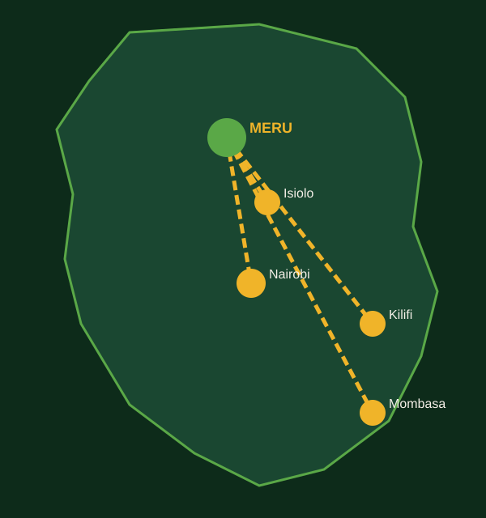
THE NETWORK
3 Sources 4 Destinations 1 Balanced Problem
SOURCES (Supply)
DESTINATIONS (Demand)
Maua (S1)
Isiolo (D1)
2,500 kg
1,500 kg
Kilifi (D2)
Laare (S2)
1,500 kg
1,800 kg
Eastleigh-Nairobi (D3)
Kangeta (S3)
2,000 kg
1,700 kg
Likoni-Mombasa (D4)
1,000 kg
BALANCED Total Supply = Total Demand = 6,000 kg No dummy node required
Notes:
Walk through the supply/demand setup. The problem is balanced — no dummy variable needed.

Slide 4
THE COST MATRIX
How each cell cost was determined
c(i,j) = c_base + c_road + c_vehicle + c_urgency (KES per kg)
Base Distance
Road Type
Vehicle Type
Urgency
km-based fuel & driver cost per route
Murram +3.5, Coastal +0.5, Tarmac 0
Probox 0, Small lorry +0.5, Ventilated +1.0
Same-day high: Isiolo +4.3, Nairobi +4.2
Source | Isiolo D1 | Kilifi D2 | Eastleigh D3 | Likoni D4 | Supply
Maua (S1) | 10 | 21 | 18 | 23 | 2,500
Laare (S2) | 11 | 22 | 16 | 23 | 1,800
Kangeta (S3) | 10 | 21 | 17 | 23 | 1,700
Demand (kg) | 1,500 | 1,500 | 2,000 | 1,000 | 6,000
Highlighted = lowest cost per source. Urgency premiums are counter-intuitively highest for nearby same-day markets, not distant ones.
Notes:
Walk through the cost formula. Key insight: urgency premiums are highest for nearby markets (same-day delivery windows).

Slide 5
VAM IN ACTION
Five Iterations, Five Decisions
1
Maua to Isiolo
1,500 kg
4
Kangeta to Kilifi
1,500 kg
Highest row penalty = 8 (S1). Lowest cost: 10 at D1. Allocate 1,500 kg. Isiolo satisfied.
Tied penalties. Tie broken by largest remaining supply (S3). Allocate 1,500 kg. Kilifi done.
2
Laare to Eastleigh
1,800 kg
5
Maua to Likoni
1,000 kg
Highest penalty = 6 (S2). Lowest cost: 16 at D3. Allocate 1,800 kg. Laare exhausted.
Only one source and destination remain. Allocate 1,000 kg. All constraints fulfilled.
3
Kangeta to Eastleigh (top-up)
200 kg
Highest penalty = 4 (S3). Lowest cost: 17 at D3. Allocate 200 kg. Eastleigh satisfied.
Notes:
Walk through each VAM iteration. Emphasise the penalty logic and tie-breaking rule in Iteration 4.

Slide 6
FINAL SCHEDULE
The Optimal Transportation Plan
Source | Isiolo D1 | Kilifi D2 | Eastleigh D3 | Likoni D4 | Supply
Maua (S1) | 1,500 ok | 0 | 0 | 1,000 ok | 2,500
Laare (S2) | 0 | 0 | 1,800 ok | 0 | 1,800
Kangeta (S3) | 0 | 1,500 ok | 200 ok | 0 | 1,700
Demand Met | 1,500 ok | 1,500 ok | 2,000 ok | 1,000 ok | 6,000
Maua to Isiolo
Maua to Likoni
Laare to Eastleigh
Kangeta to Kilifi
Kangeta to Eastleigh
1,500 kg
1,000 kg
1,800 kg
1,500 kg
200 kg
@ KES 10/kg
@ KES 23/kg
@ KES 16/kg
@ KES 21/kg
@ KES 17/kg
= KES 15,000
= KES 23,000
= KES 28,800
= KES 31,500
= KES 3,400
Notes:
Present the complete allocation table. Every kg accounted for.

Slide 7
THE RESULT
KES 101,700
Minimum Total Transportation Cost
5
6,000 kg
100%
~17 KES/kg
Active Routes
(out of 12 possible)
Miraa delivered
without spoilage
Supply & Demand
constraints satisfied
Average cost
per kilogram
Notes:
Let the number breathe. VAM found this in 5 iterations.

Slide 8
PRACTICALITY & INSIGHT
From Classroom to the Road
01
Immediately Deployable
02
Urgency Logic Embedded
The five-route schedule is simple enough for field use without computational tools. Traders can implement it today.
Counter-intuitively, Isiolo's urgency premium (KES 4.3/kg) dwarfs Kilifi's (KES 0.3/kg). Nearby same-day windows are the tightest.
03
Road-Aware Routing
04
Recommended Next Step
Murram road penalties (+3.5 KES/kg for Isiolo routes) reflect real vehicle wear and delay costs, not just kilometres.
Verify with PuLP (Python) or Excel Solver to confirm global optimality. The tied penalty in Iteration 4 warrants a confirmatory run.
DSA 8302 Strathmore University Transportation of Miraa (Meru County) Using VAM
Notes:
Close with practical takeaways.

Slide 9
GROUP MEMBERS
DSA 8302 Transportation of Miraa
#
Full Name
Admission No.
1
Dennis Muasya Wambua
121544
2
Simion Mike Mbumbu
222076
3
Fridah Nkirote Mutabari
111033
4
Angela Moraa Omweri
223763
5
Esther Muthui
223932
6
Christopher Kioko
224157
7
Valerie Jerono
222331
Strathmore University Institute of Mathematical Sciences 2024/2025
Notes:
Fill in group member names and admission numbers before presenting.

